Slide 1
Machine Learning on Stock Market Data
Team Members:
Khushbu Parekh
Tapadyuti Maiti

Slide 2

Problem Statement
Stock Prices are totally random and unpredictable
Its volatile in nature
Foresee whether tomorrow’s exchange closing price is going to be lower or higher with respect to today
The successful prediction of a stock's future price could yield significant profit.

Slide 3

The solution
Model the Top 5 Companies and DOW 30 and Predict future Stock Prices based on our Models.
Linear Regression , Random Forest , KNN with Neural Network
Sentiment Analysis from the Twitter Data for all the DOW 30 , and selected companies

Slide 4
Selected Top 5 Stock Market
HEALTH - Jhonson & Jhonson
FINANCE - Bank of America
TECHNOLOGY - Apple
ENERGY - Exxon Mobil Corporation
TELECOMMUNICATION - AT&T

Slide 5
1.Data Ingestion
We are taking the data from the YAHOO Finance as the Financial Data, from the Reddit TOP News and Twitter Feeds as input for performing sentiment Analysis.
Yahoo Finance
Twitter Data for Specific Stock Ticker
Google Trends
Link for Data 2005 - 2017
Yahoo Finance Data
Python Package : tweepy

Slide 6
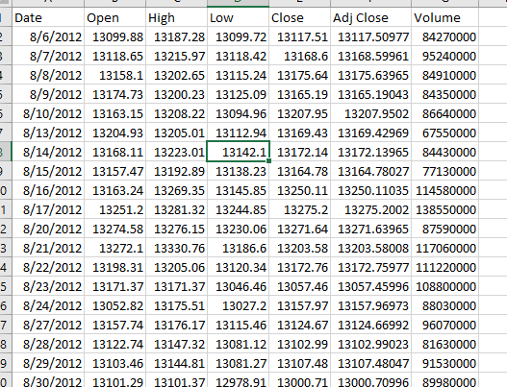
Sample Dataset :
Date : Date of Stock Exchange Operation
Open :The price of the first trade for any listed stock is its daily opening price(USD$)
High: Highest price at which a stock traded during the course of the day (in US dollars)
Low: Lowest price at which a stock traded during the course of the day (in US dollars)
Adjusted Close: price of the stock at the closing of the trading adjusted with dividends (in US dollars)
Volume: Total Number of a security that were traded during a given period of time

Slide 7
Tools
•Python – Data processing and Machine Learning Algorithm
•Docker – For easy distribution and submission.
•Python – Web application, REST API.
•Amazon – EC2, S3.

Slide 8

Web Application

Slide 9
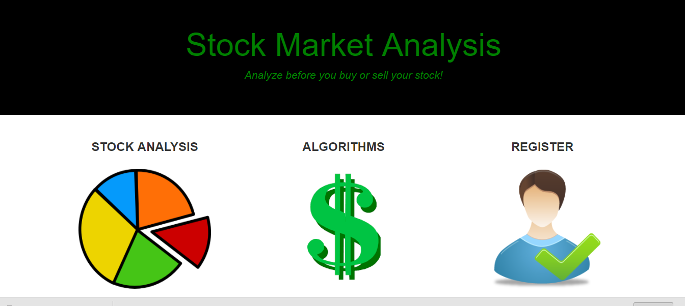

Slide 10
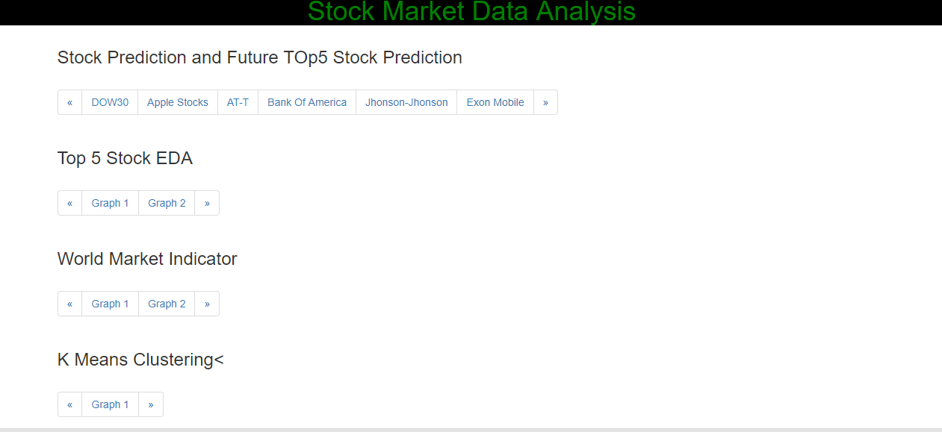

Slide 11
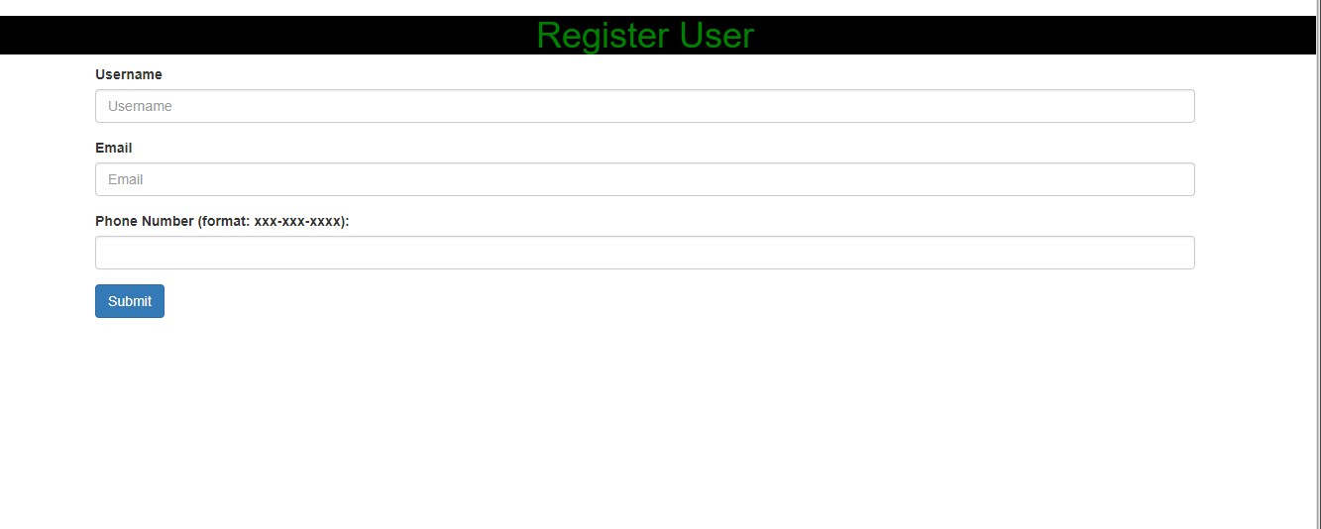

Slide 12
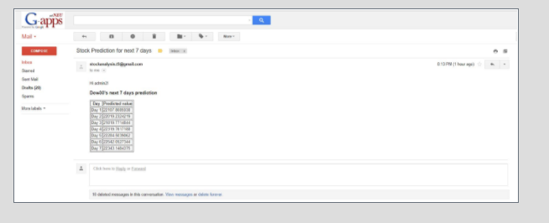

Slide 13

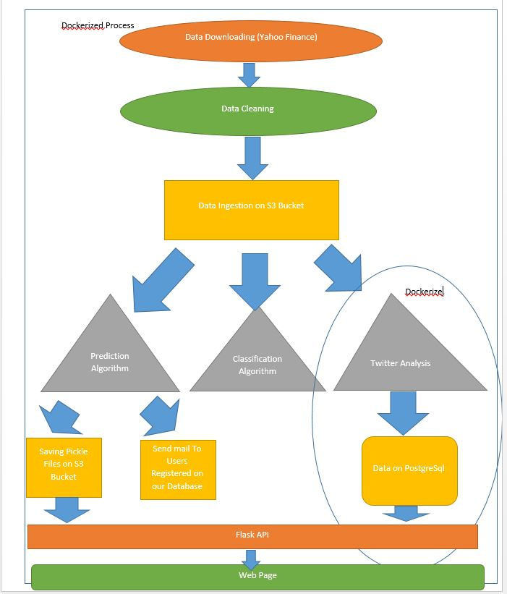
System Architecture
Data Ingestion
Data Wrangling
Clean Data on S3
Modelling the data - ML
Web App using Rest API

Slide 14
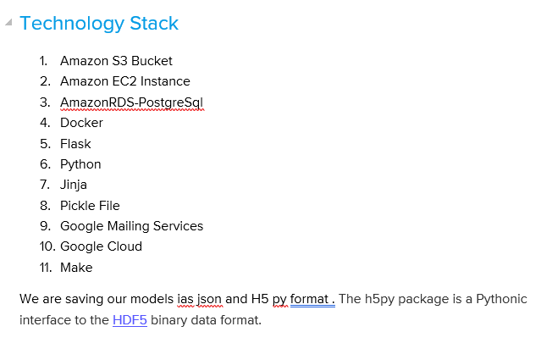

Slide 15
Dow 30 Data Import from all the major Market Indicators around the World NASDAQ Composite (^IXIC Yahoo Finance) - USA Dow Jones Industrial Average (^DJI Yahoo Finance) -USA Frankfurt DAX (^GDAXI Yahoo Finance) - Germany London FTSE-100 (^FTSE Yahoo Finance) - UK Paris CAC 40 (^FCHI Yahoo Finance) - France Tokyo Nikkei-225 (^N225 Yahoo Finance) - Japan Hong Kong Hang Seng (^HSI Yahoo Finance) - China (H/K) Australia ASX-200 (^AXJO Yahoo Finance) - Australia

Slide 16
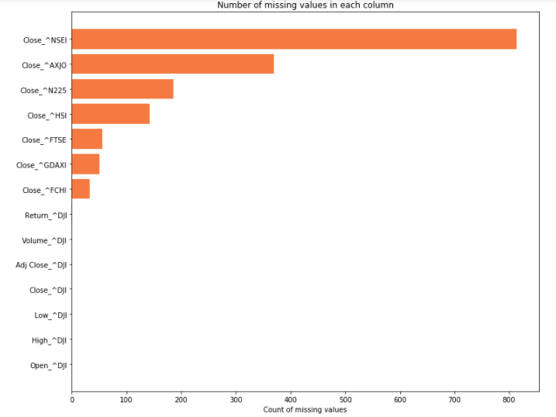
Data Wrangling : Handling Missing Data

Slide 17
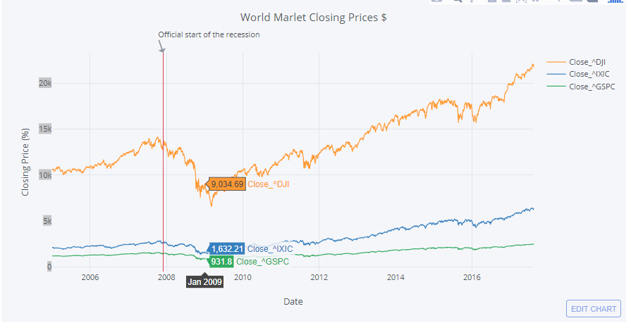
Exploratory Data Analysis

Slide 18
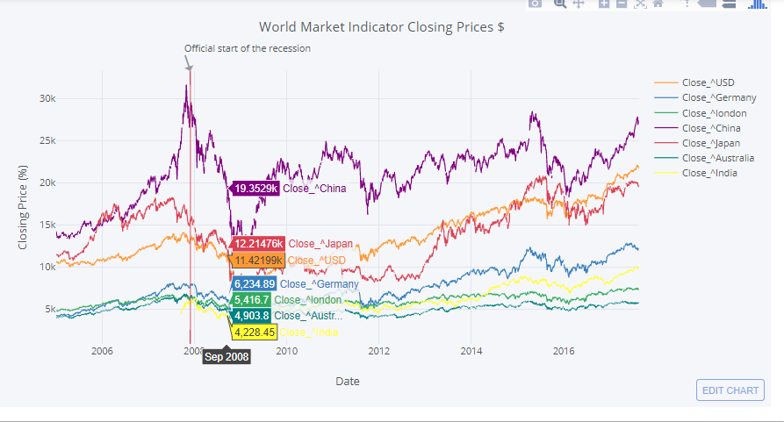

Slide 19
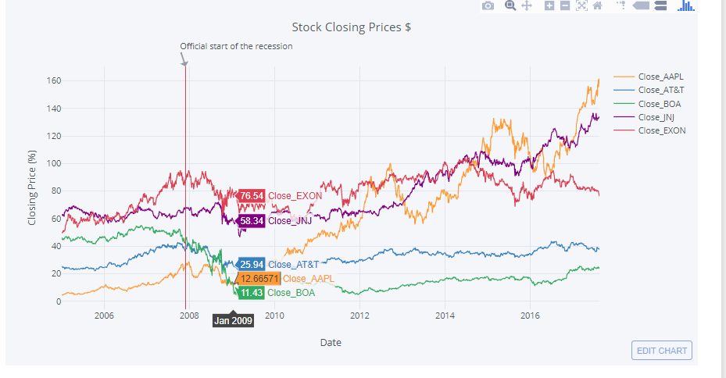

Slide 20
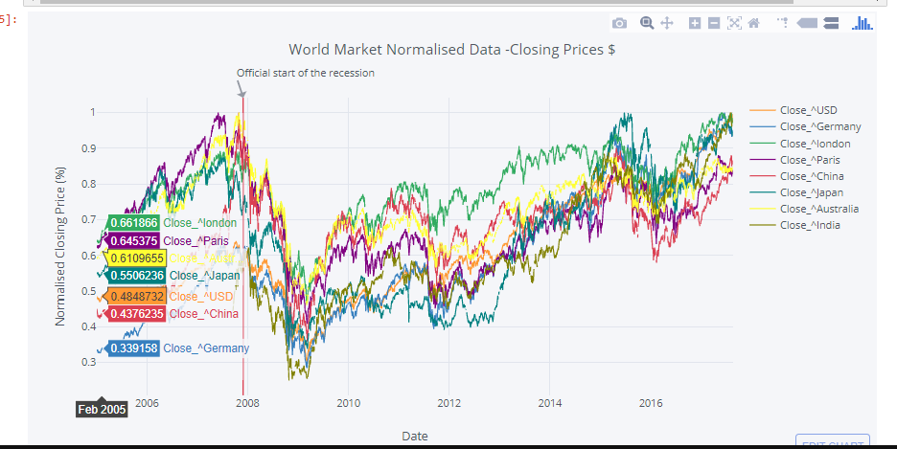

Slide 21
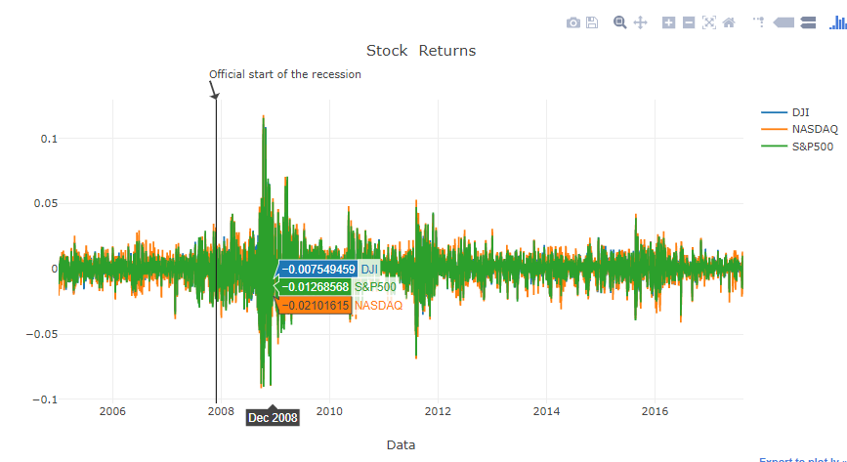

Slide 22
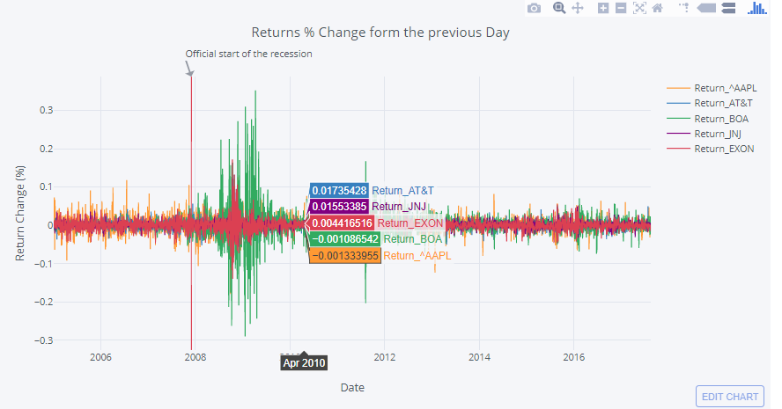

Slide 23
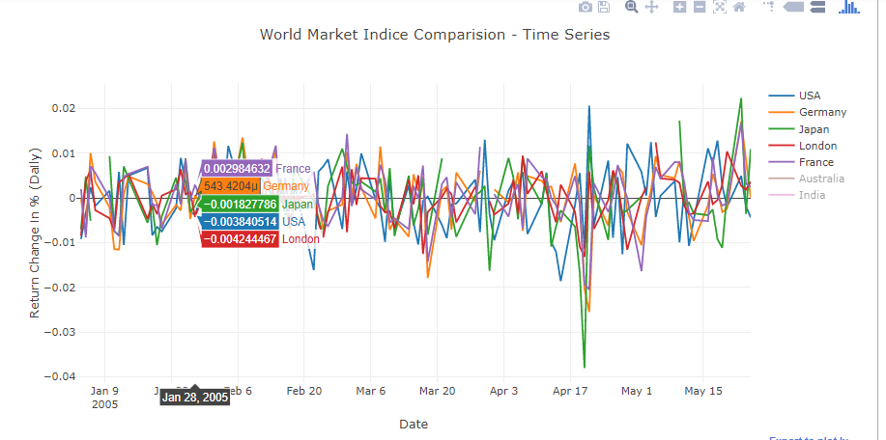

Slide 24
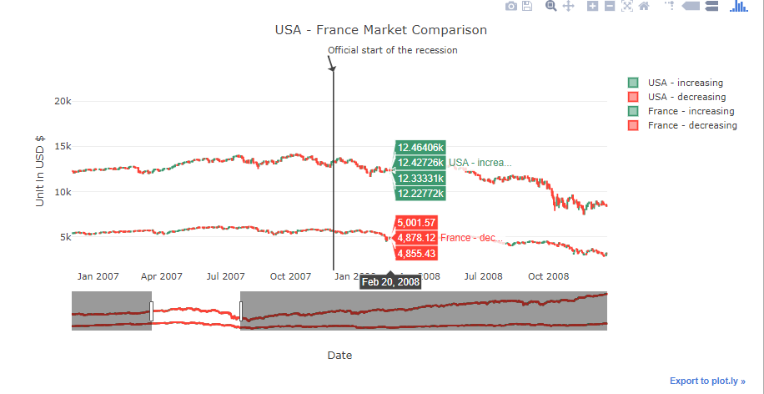

Slide 25
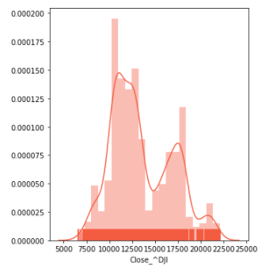
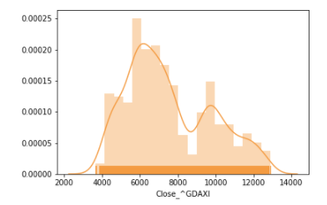
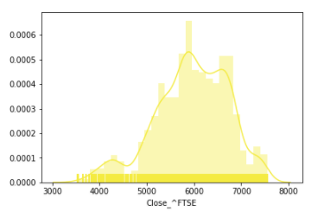

Slide 26
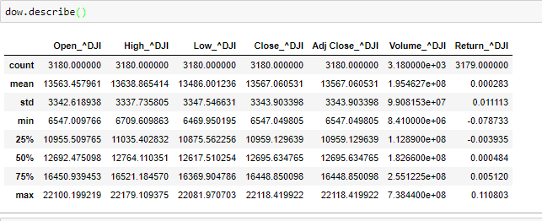

Slide 27
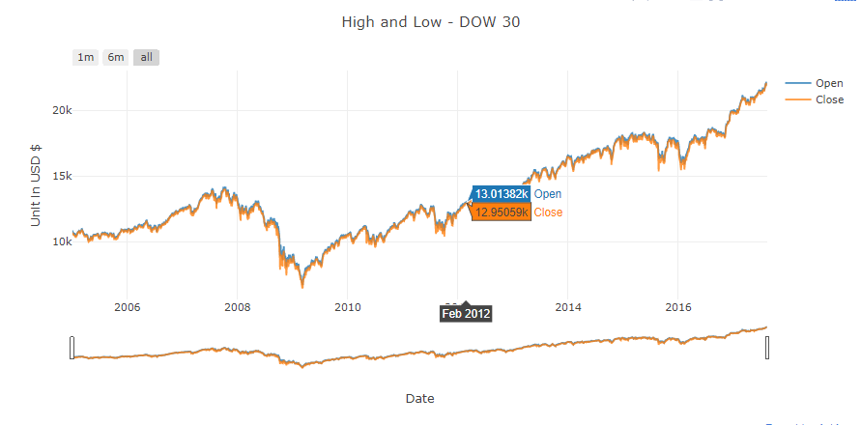

Slide 28
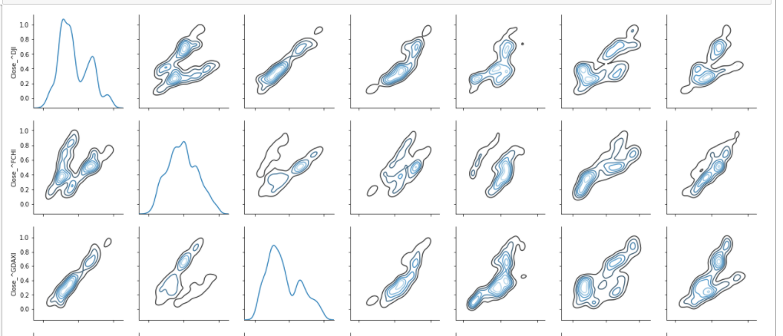
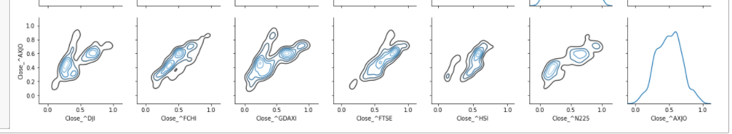

Slide 29
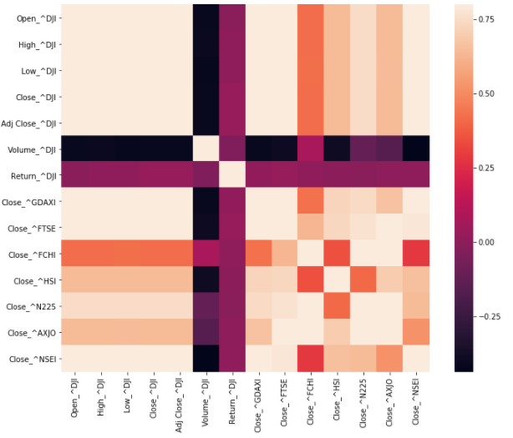

Slide 30
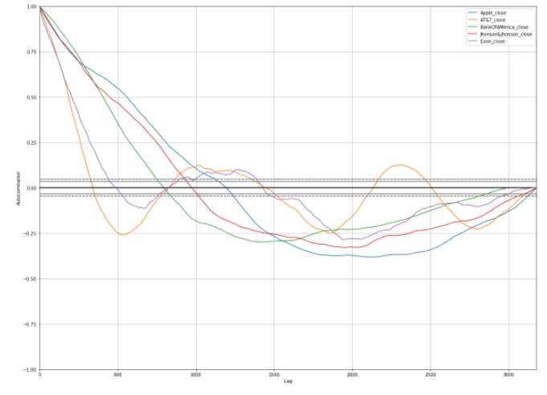

Slide 31
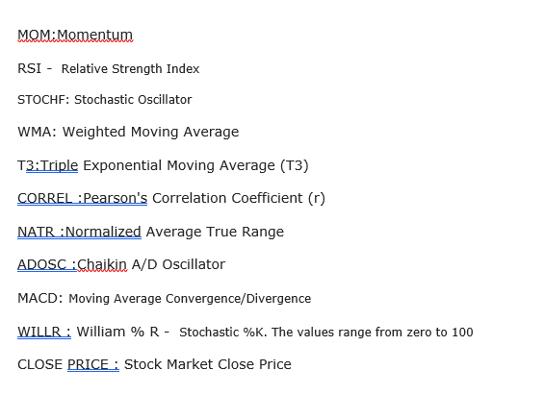

Slide 32
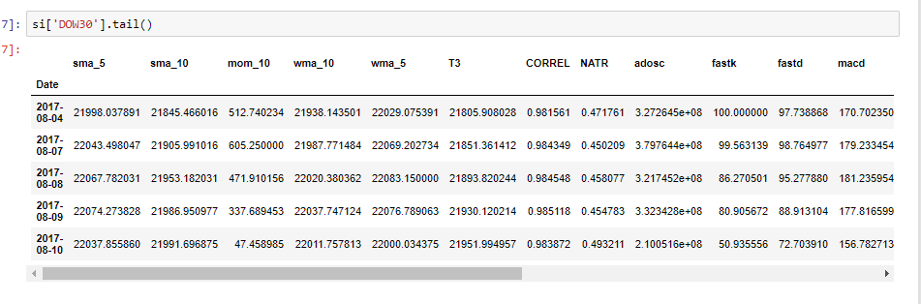

Slide 33
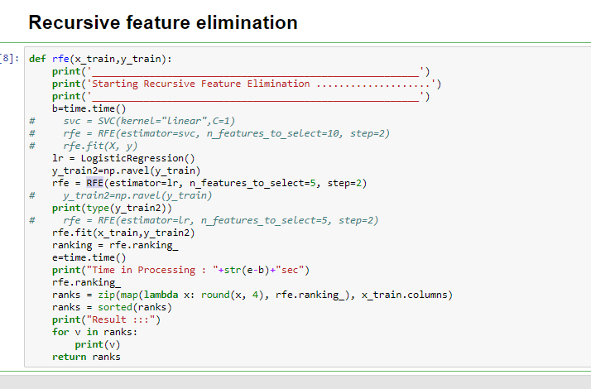

Slide 34
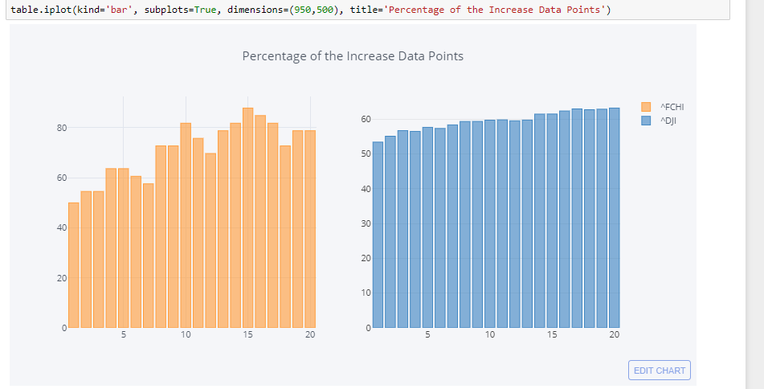

Slide 35
Training Data and Test Data
Date | Feature1 | FEature2 | FEature3 | FEature4 | CLosePrice
1
2 |  |  |  |  | 1
3 |  |  |  |  | 2
4 |  |  |  |  | 3
5 |  |  |  |  | 4
6 |  |  |  |  | 5
7 |  |  |  |  | 6

Slide 36
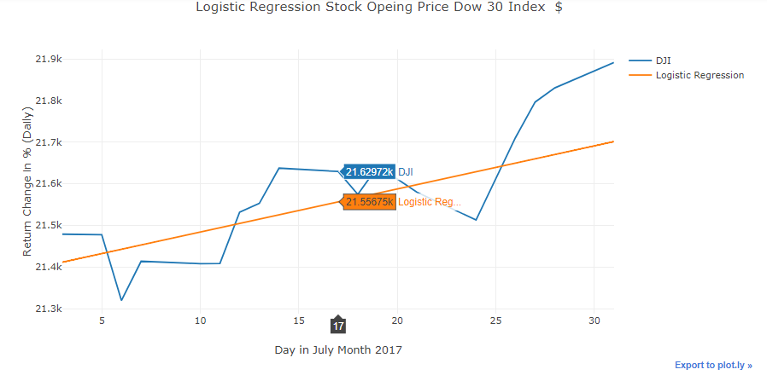

Slide 37
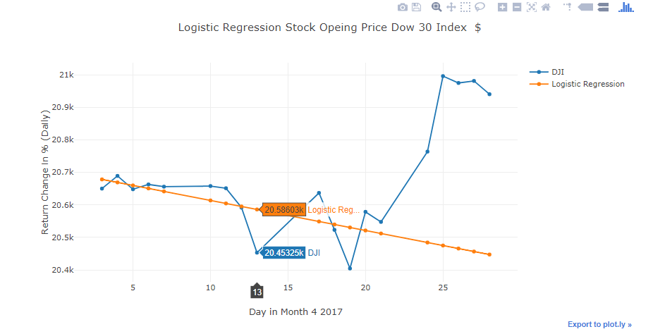

Slide 38
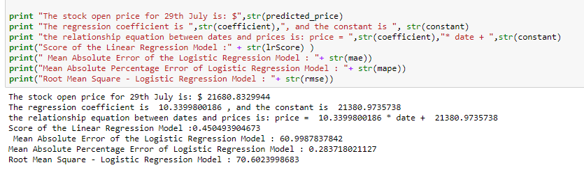
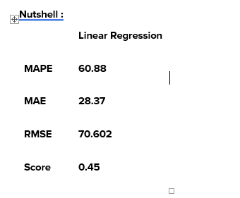

Slide 39
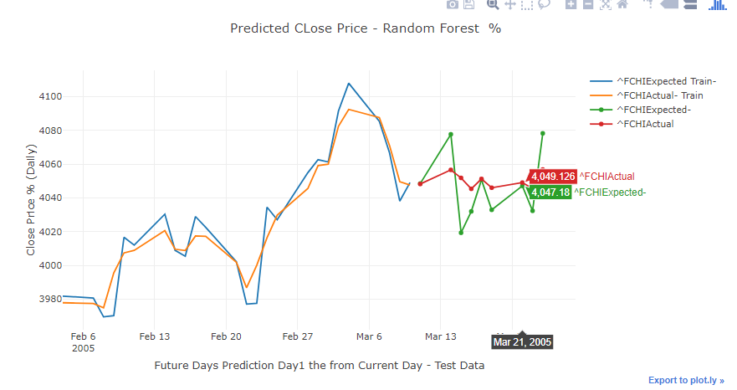

Slide 40
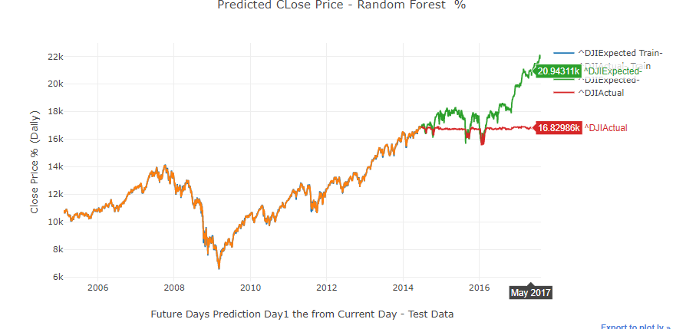

Slide 41
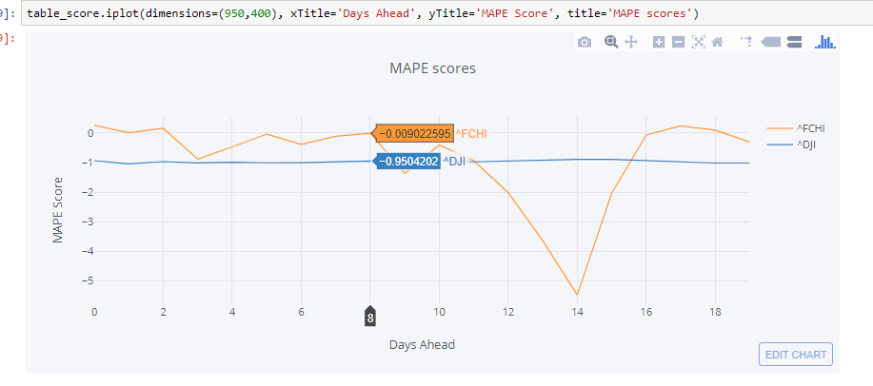

Slide 42
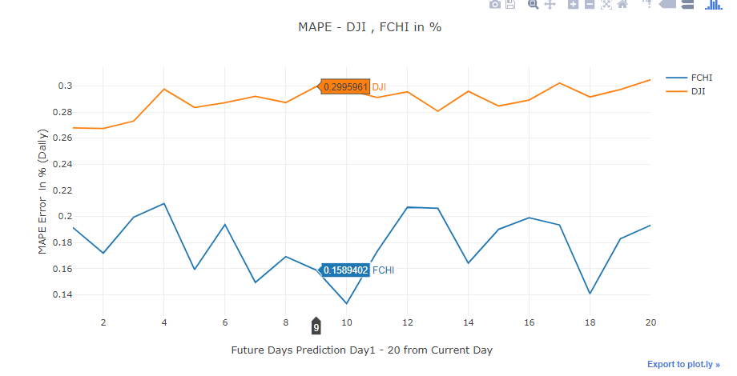

Slide 43
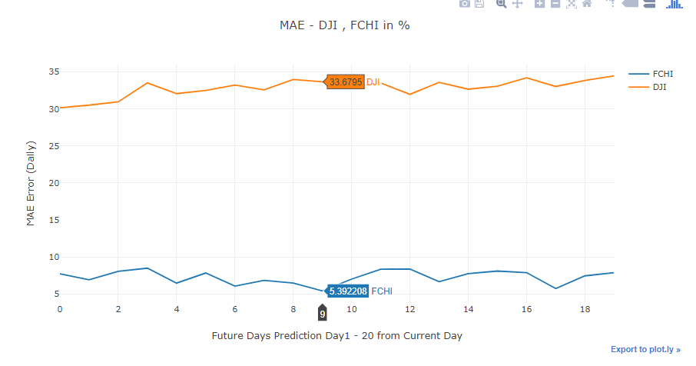

Slide 44
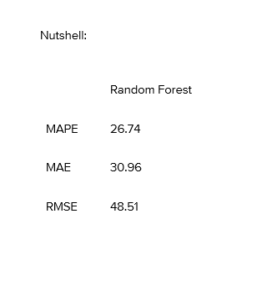

Slide 45
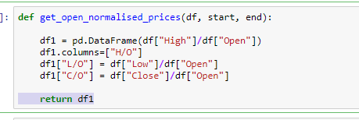
Neural Network

Slide 46
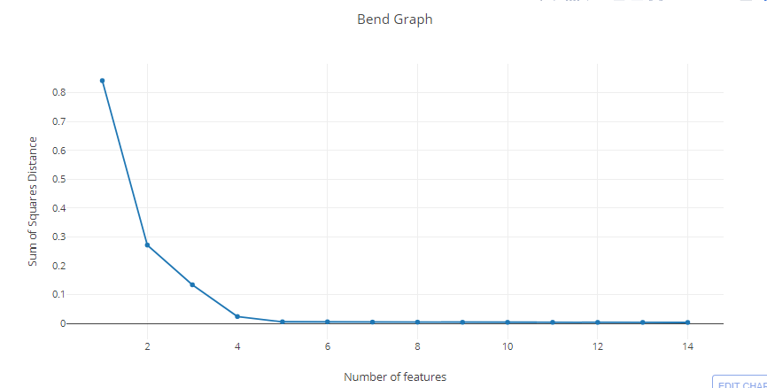

Slide 47
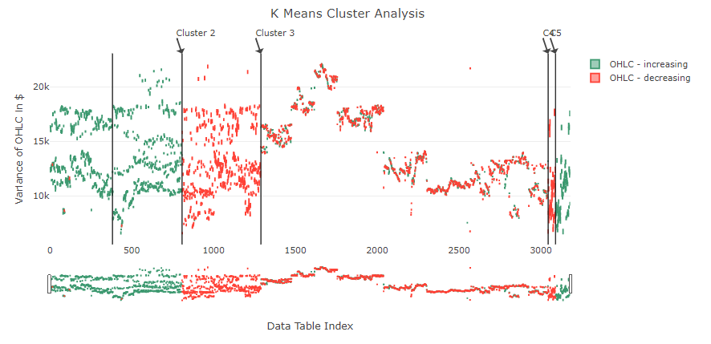

Slide 48
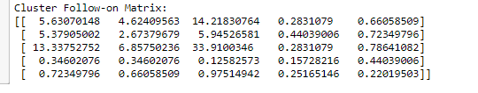
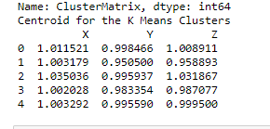

Slide 49
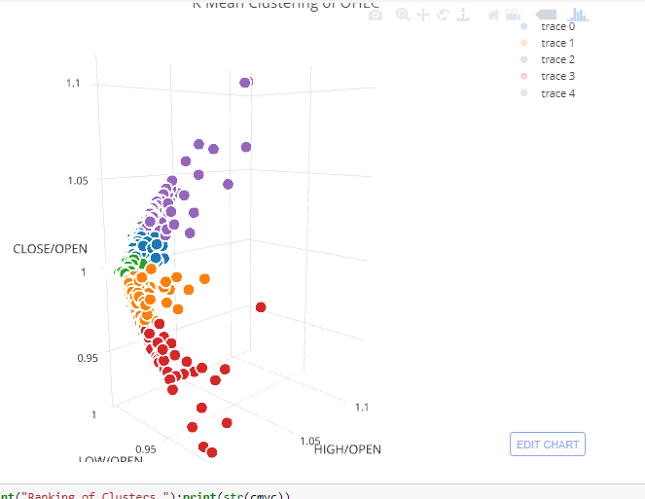

Slide 50
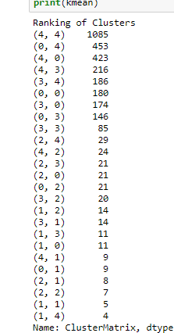

Slide 51
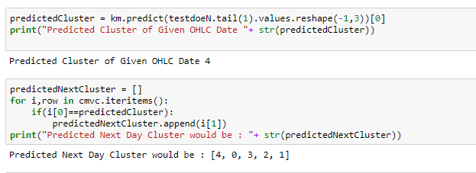
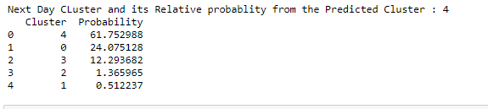

Slide 52
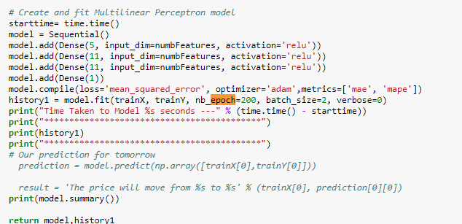

Slide 53
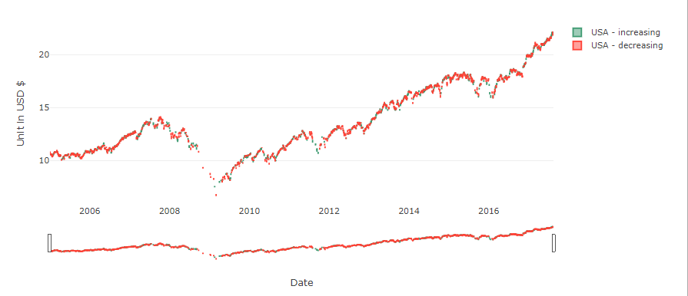

Slide 54


Slide 55


Slide 56


Slide 57


Slide 58


Slide 59




Slide 60
Parallel Processing – multiprocessing Library

Slide 61


Slide 62




Slide 63


Slide 64


Slide 65


Slide 66
Youtube link: https://youtu.be/LETQ6bjLGhQ

Slide 67
Thank You !

